Slide 1
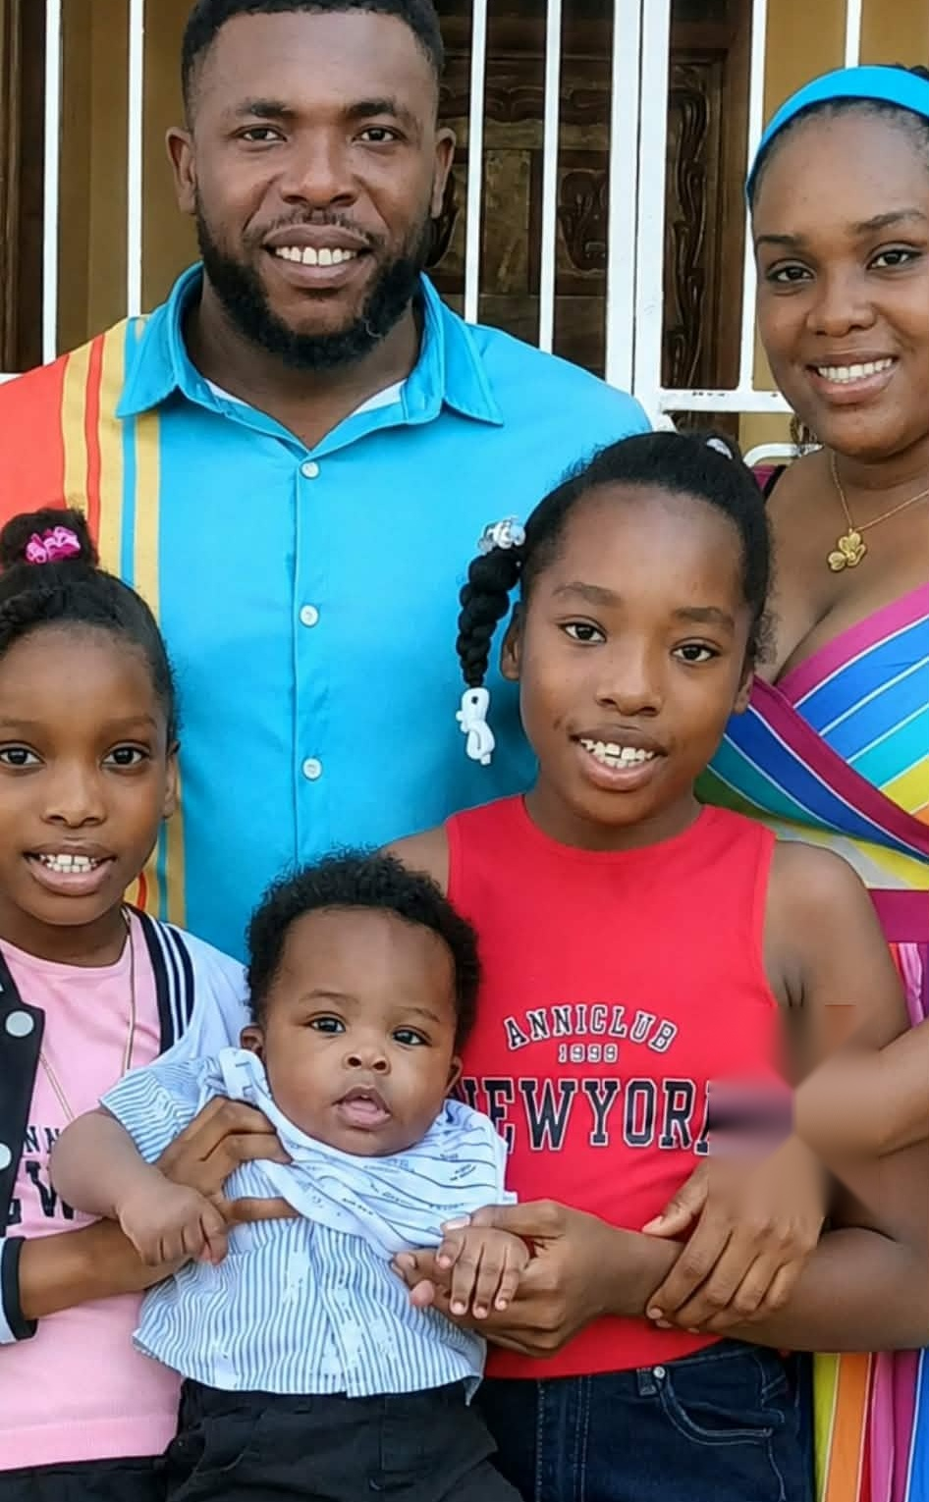

Thank You
Beulaville Baptist Church
With love from Pastor René Romil & Family
Notes:
SHOW WHEN HE SAYS: "Good morning, church leaders, brothers and sisters in Christ."
Have this slide up before he begins.

Slide 2
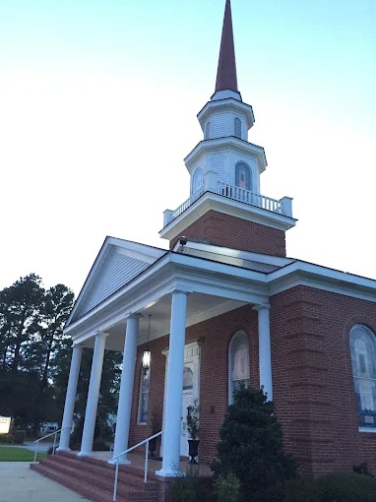

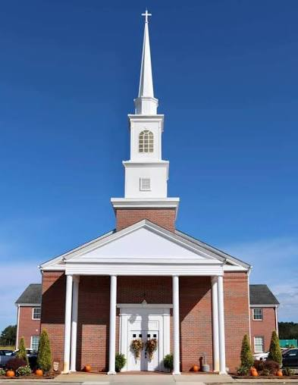
Thank You
Beulaville Baptist Church
Pastor Bartley Wooten
for friendship, encouragement and support
Notes:
SHOW WHEN HE SAYS: "Thank you for welcoming me into this church."

Slide 3
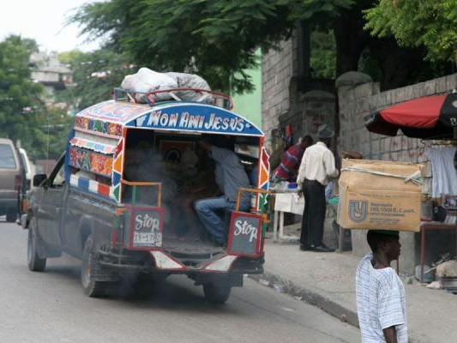
My Journey to You!
4
Four bus taxi rides to the border of the Dominican Republic
Notes:
SHOW WHEN HE SAYS: "(Not in the written script.) Show when he talks about his trip to the USA."
Ask the pastor where he wants to tell the travel story.

Slide 4


Bus from the Border to
Las Américas Airport
In the Dominican Republic
Could not use the airports in Haiti
Notes:
SHOW WHEN HE SAYS: "(Not in the written script.) Follows the bus taxi slide."

Slide 5
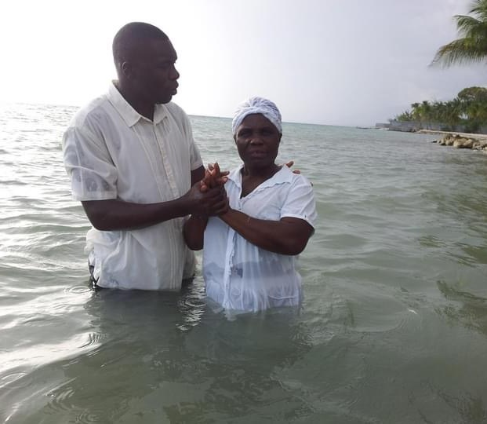

René Romil
Christian Educator
Theologian
Pastor
Director
Notes:
SHOW WHEN HE SAYS: "My name is René Romil."

Slide 6
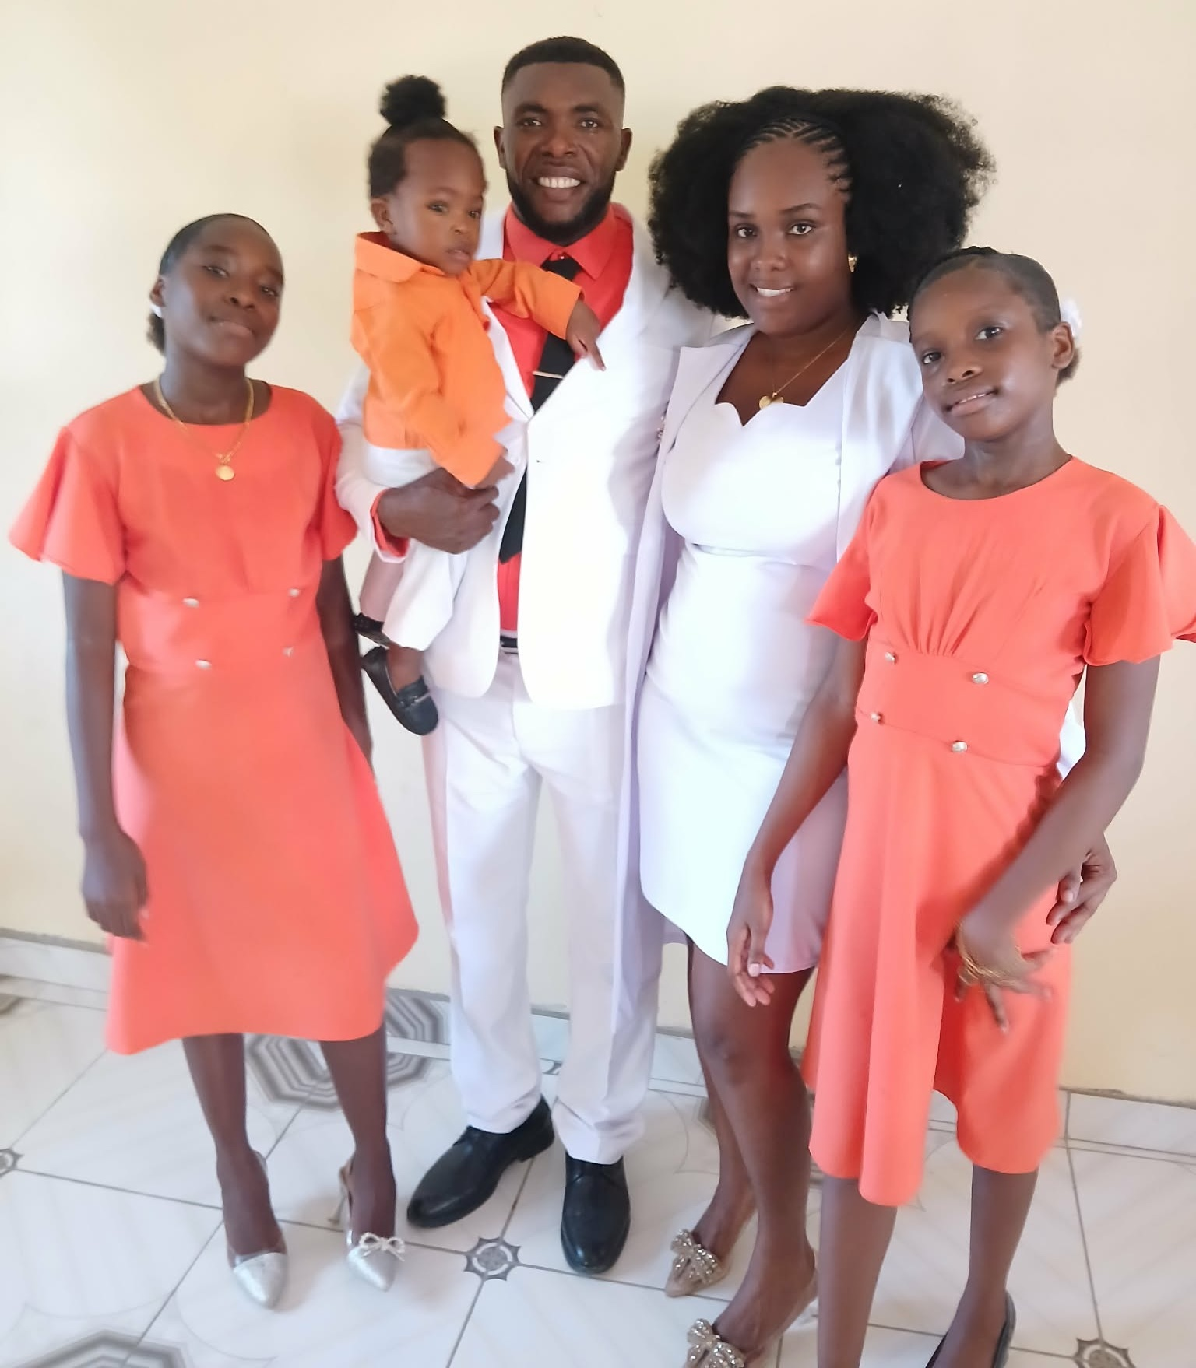

My Family
My wife, Charles Mitchama, serves alongside me
God has blessed us with children
Notes:
SHOW WHEN HE SAYS: "My wife, Charles Mitchama, serves alongside me"

Slide 7
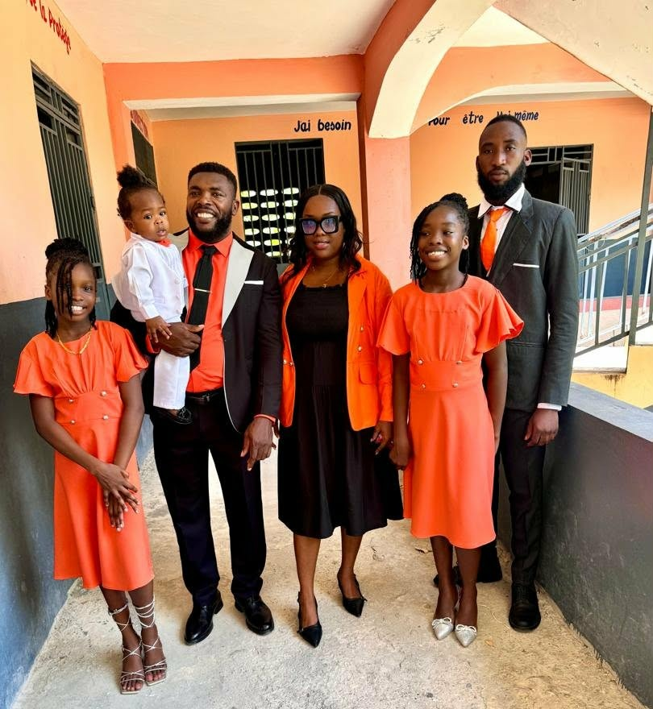

Ministry Is a Calling
Not simply a profession
Serving people, families, children, young people, churches and communities
Notes:
SHOW WHEN HE SAYS: "For me, ministry is not simply a profession. It is a calling."

Slide 8



Our Vision
Proclaim Christ
Educate Children
Strengthen Families
Develop Communities
Give Hope
Notes:
SHOW WHEN HE SAYS: "Our vision is simple"

Slide 9
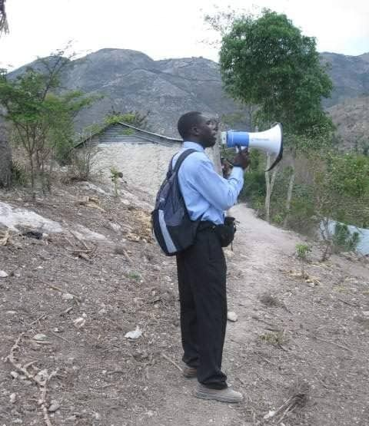

It Began with Faith
No large organization
No large budget
No large building
Pastor Romil preaching after the hurricane in 2010
Notes:
SHOW WHEN HE SAYS: "I want to briefly explain how I came to this ministry."

Slide 10
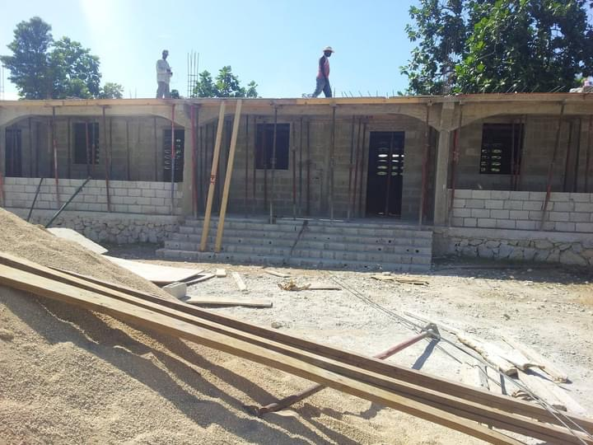

Building the School
MIFOCA School under construction
Notes:
SHOW WHEN HE SAYS: "I believed that if God could use one person who was willing to serve"
First of 3 photo slides here. Advance through them slowly before 'God opened doors.'

Slide 11
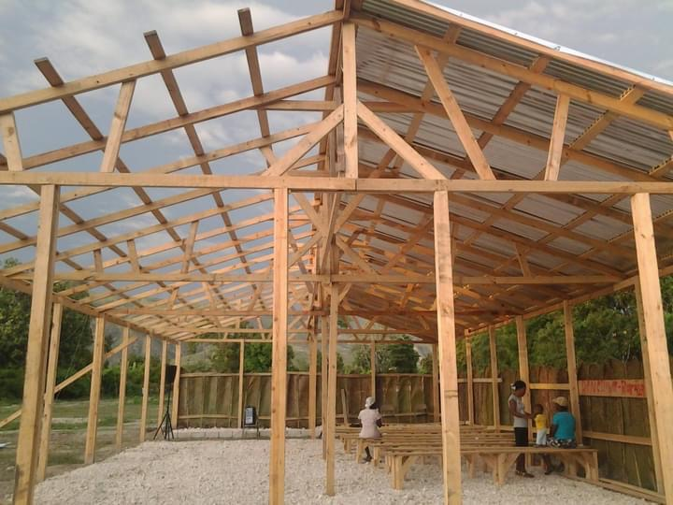

Building the Church
MIFOCA Baptist Church under construction
Notes:
SHOW WHEN HE SAYS: "(continue) He could begin something that would eventually touch many lives."

Slide 12
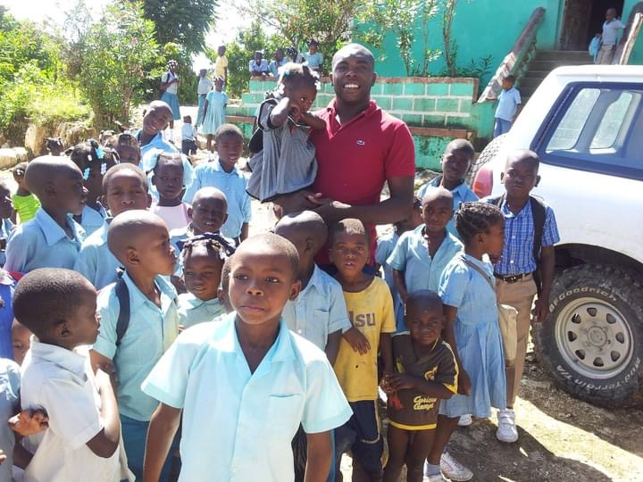

Our Students
Pastor Romil with MIFOCA students
Notes:
SHOW WHEN HE SAYS: "(continue) Leave up until he says 'Over the years, God opened doors.'"

Slide 13
God Opened Doors
One child
Many children
One family
Many families
One small ministry
A church, a school, programs and projects
Notes:
SHOW WHEN HE SAYS: "Over the years, God opened doors."

Slide 14
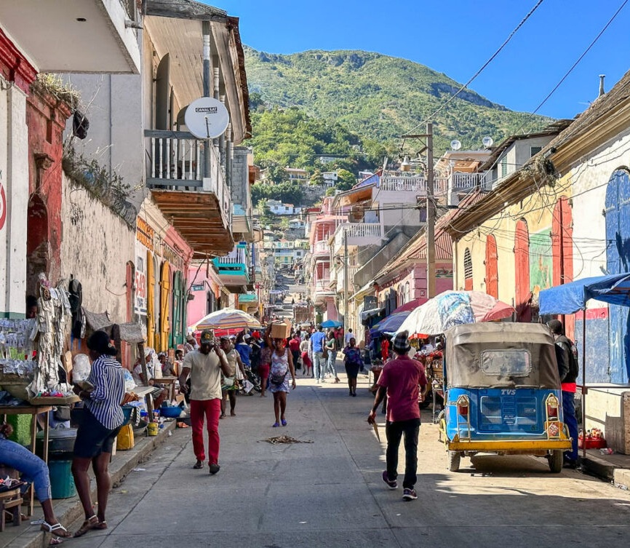

Haiti: A Beautiful Country, Beautiful People
Resilient
Creative
Hardworking
Strong in faith and culture
Notes:
SHOW WHEN HE SAYS: "Haiti is a beautiful country with beautiful people."

Slide 15
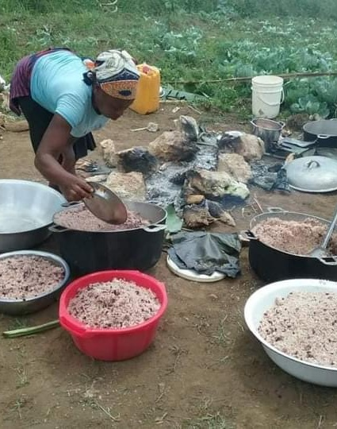




Haiti's Challenges
Families struggle to earn a living
Insecurity and political instability
Hard to get a good education
Not enough food for children
Few jobs for young people
Notes:
SHOW WHEN HE SAYS: "But Haiti is also facing enormous challenges."

Slide 16
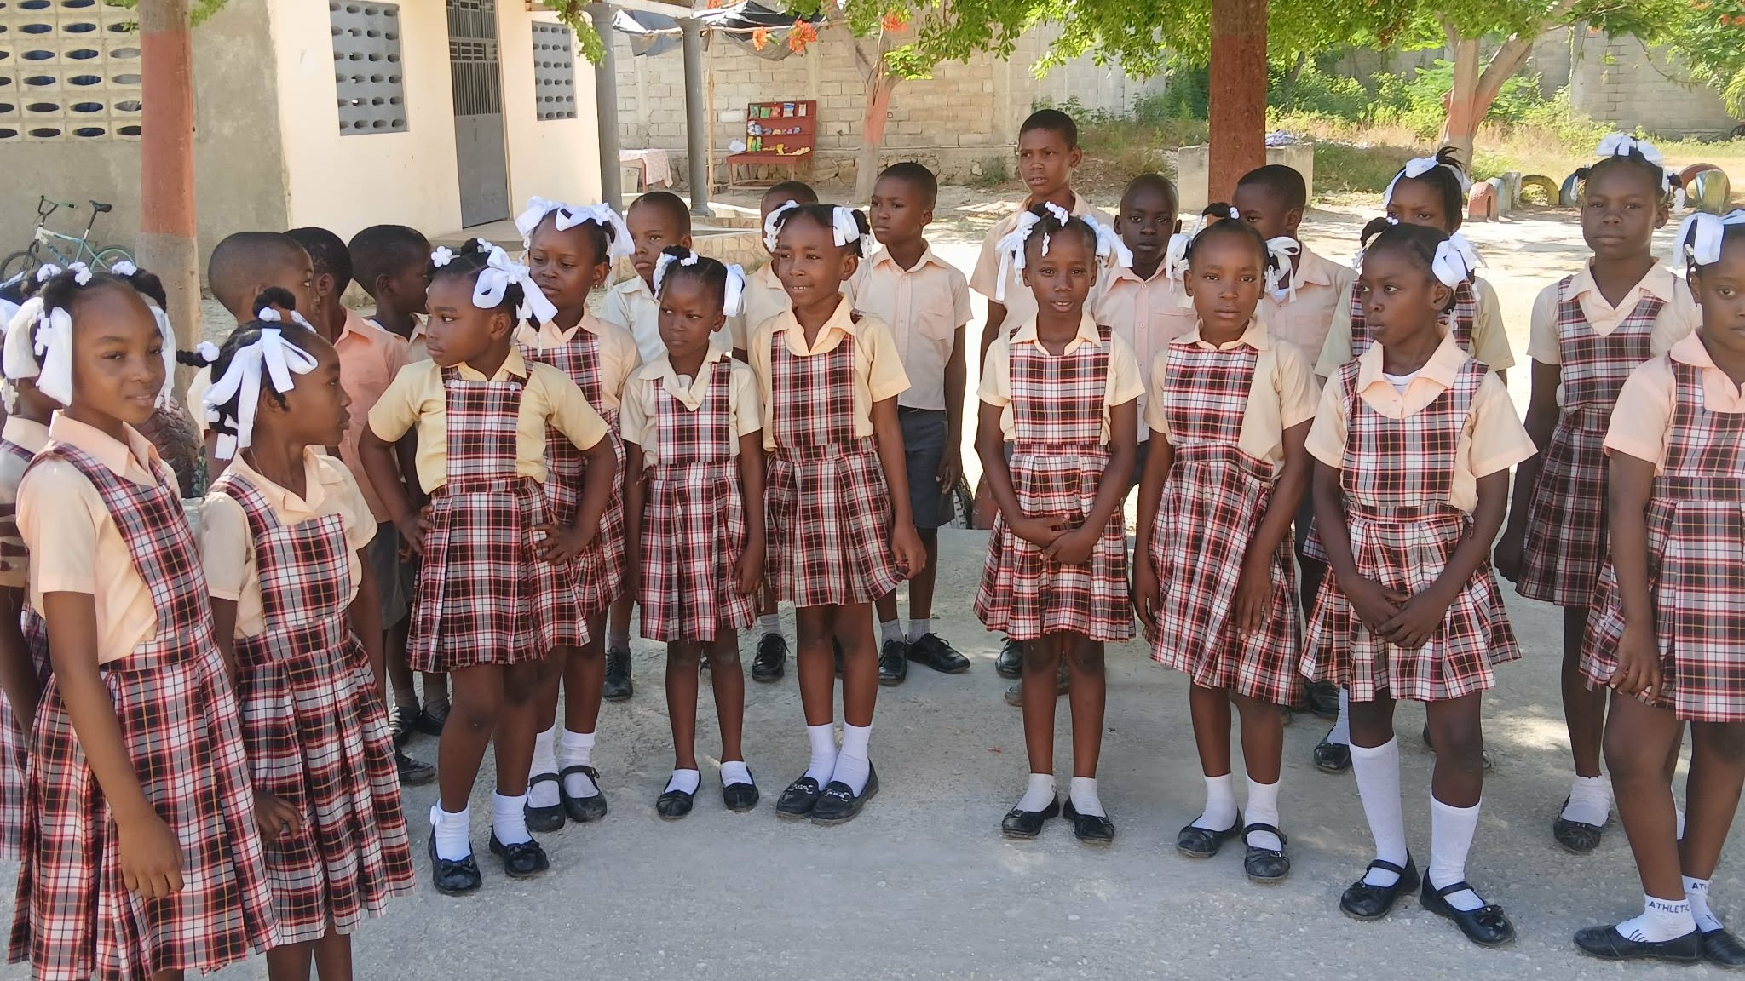
Haiti's Story Is Not Finished
There is hope, and the Church has a role to play.
Notes:
SHOW WHEN HE SAYS: "We do not believe Haiti's story is finished."

Slide 17
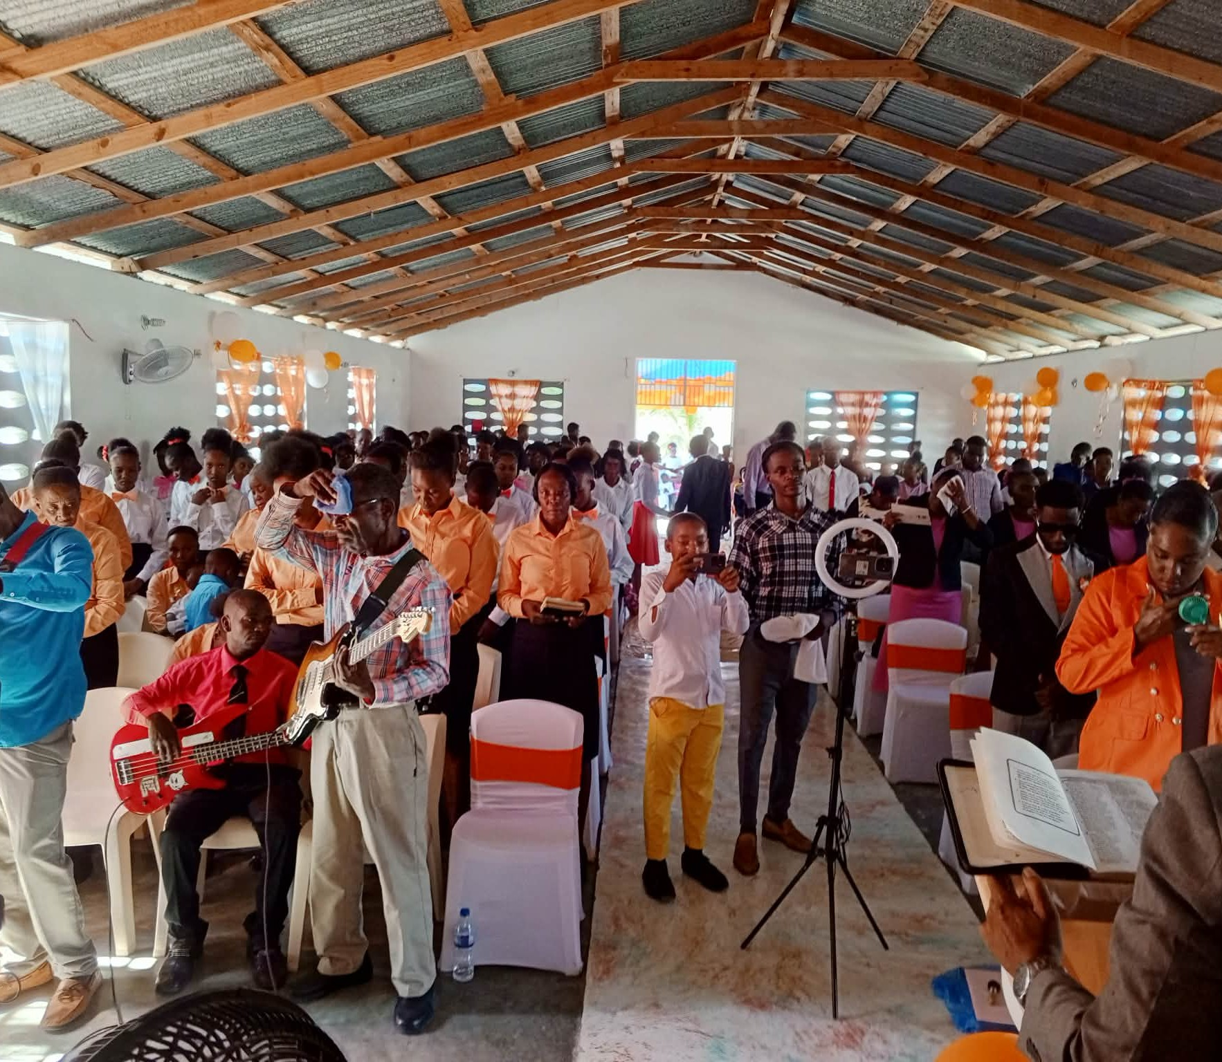
MIFOCA Baptist Church
near Arcahaie, Haiti
Proclaiming the Gospel of Jesus Christ
Notes:
SHOW WHEN HE SAYS: "One of the central parts of our ministry is MIFOCA Baptist Church in Saintard."

Slide 18
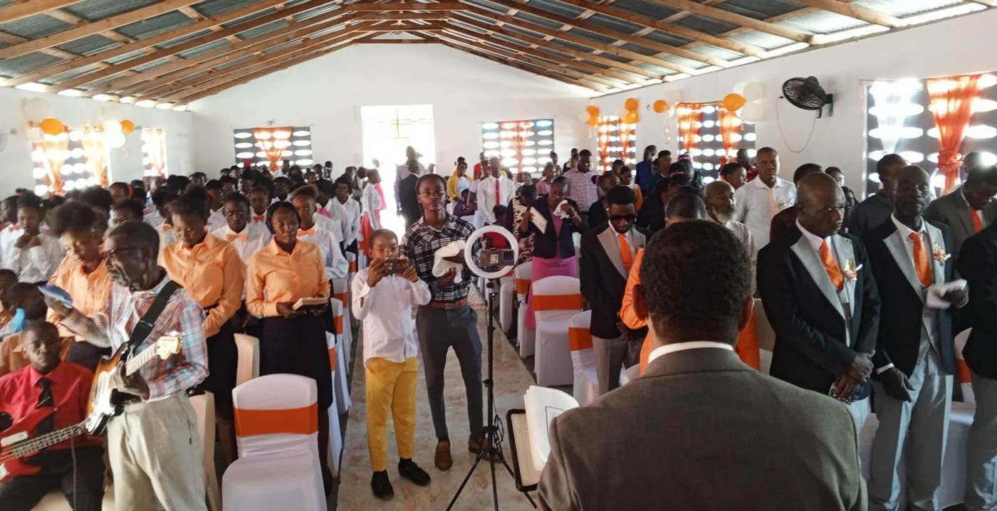
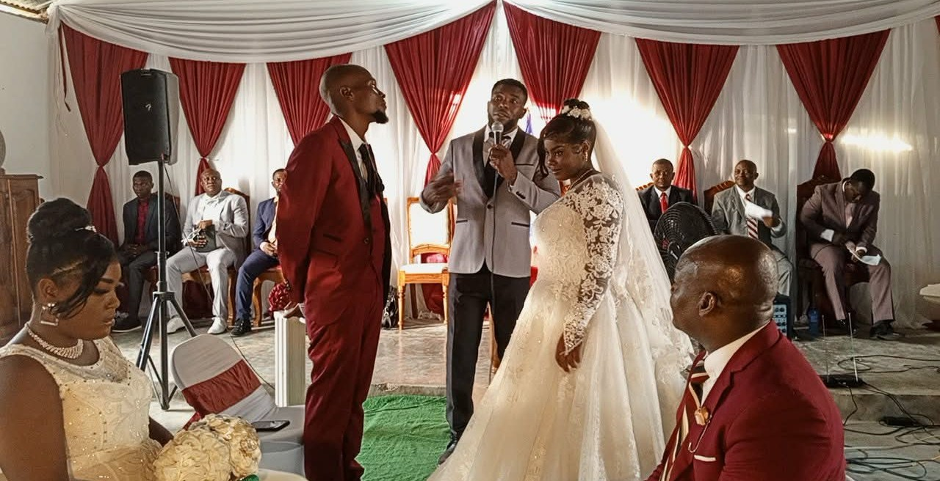
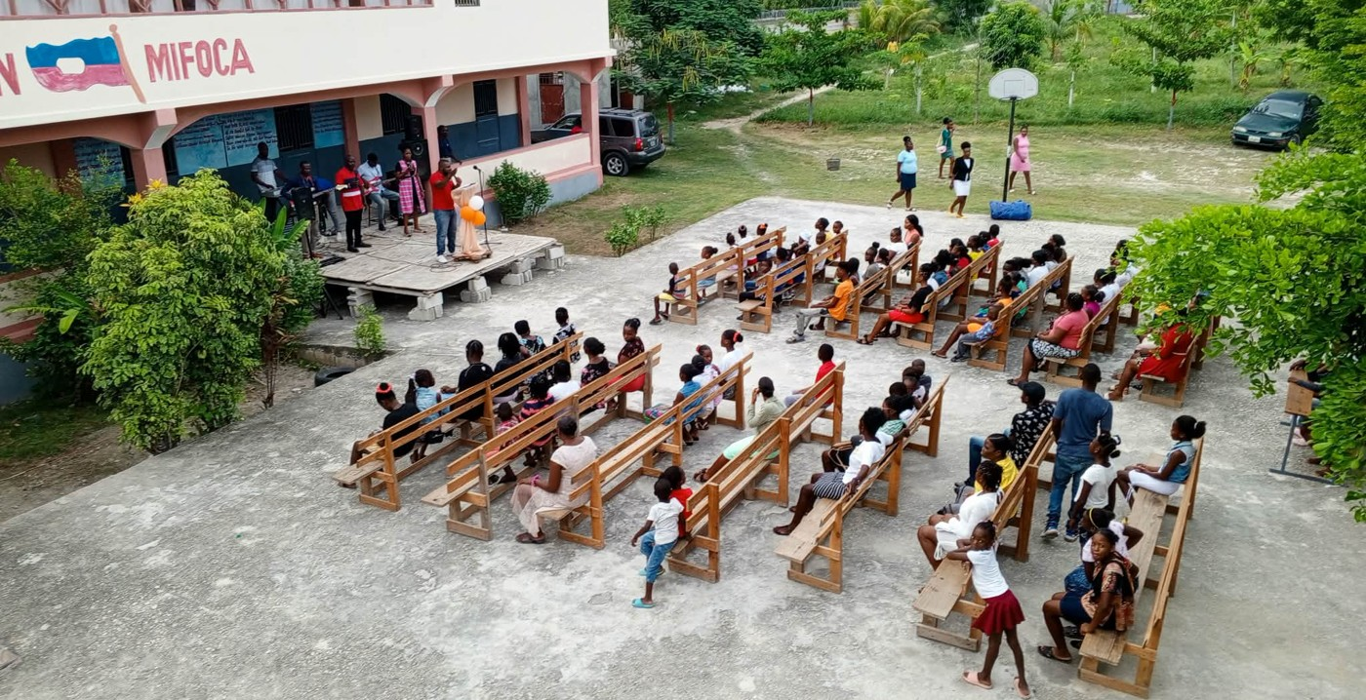
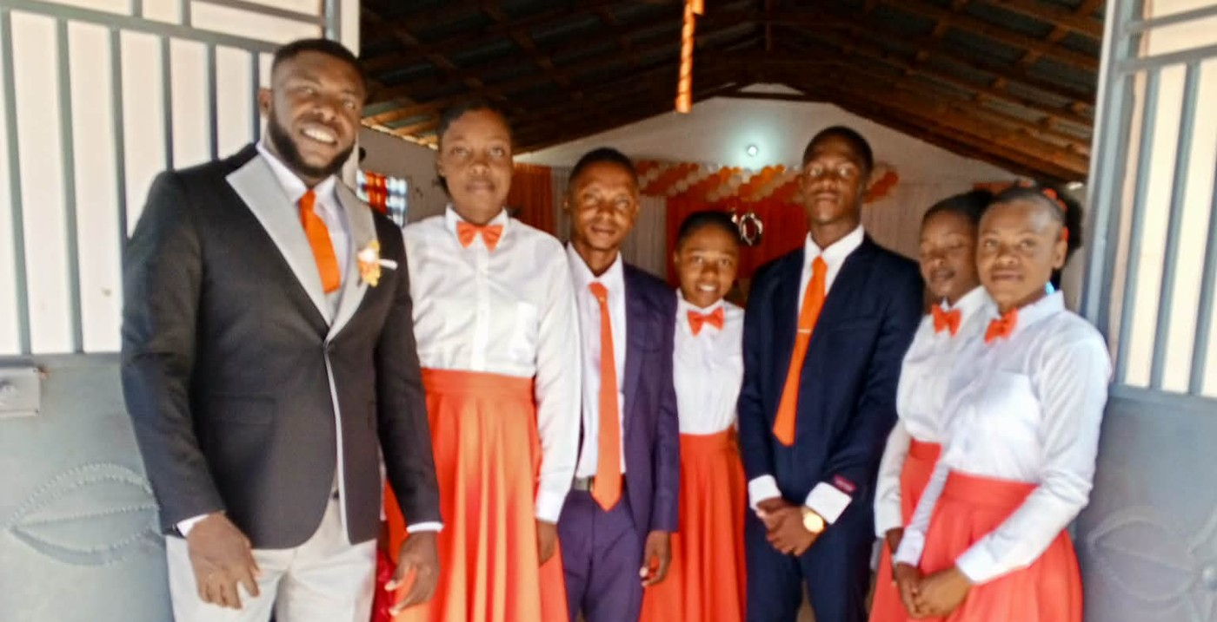
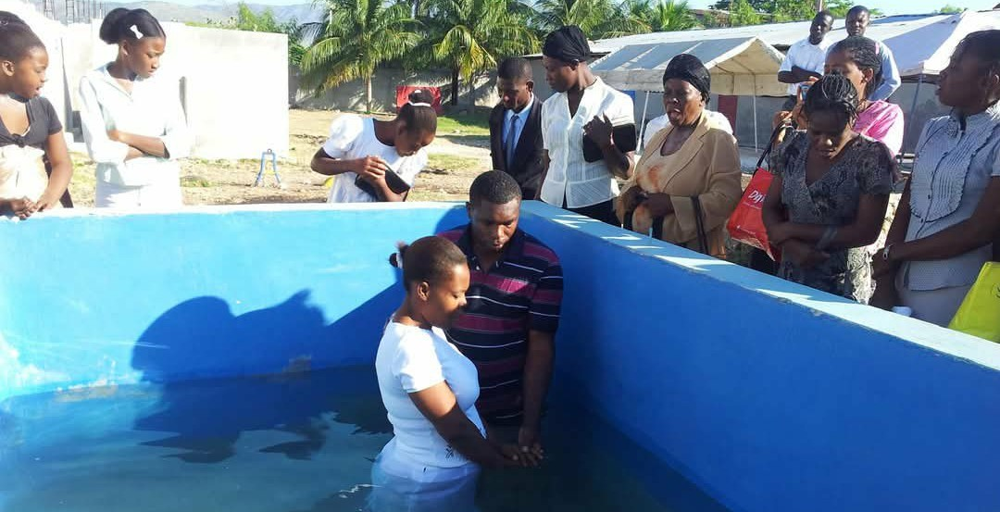
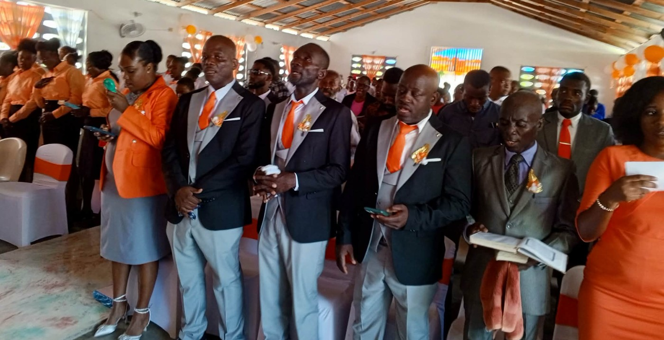
Church Life
Worship
Wedding
Outdoor Worship
Youth
Baptism
Leadership
Know Christ • Grow in Christ • Serve Christ
Notes:
SHOW WHEN HE SAYS: "We have worship services, prayer meetings, Bible studies"

Slide 19
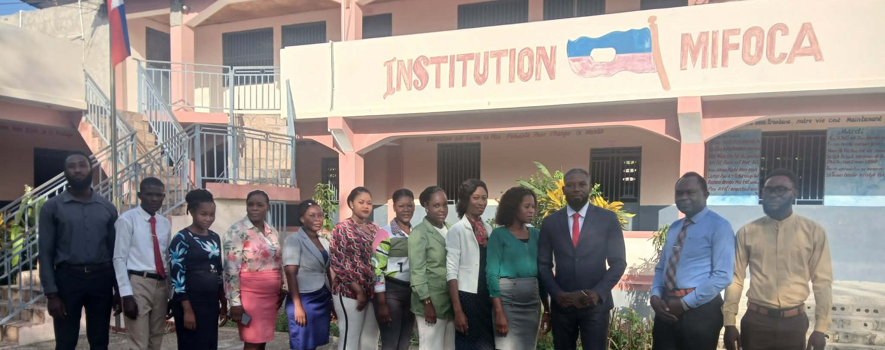
MIFOCA School
Institution Mixte Foi Chrétienne en Action
Open since September 2015
Preschool through the fundamental grades
Notes:
SHOW WHEN HE SAYS: "Another major part of our ministry is Institution Mixte Foi Chrétienne en Action"

Slide 20
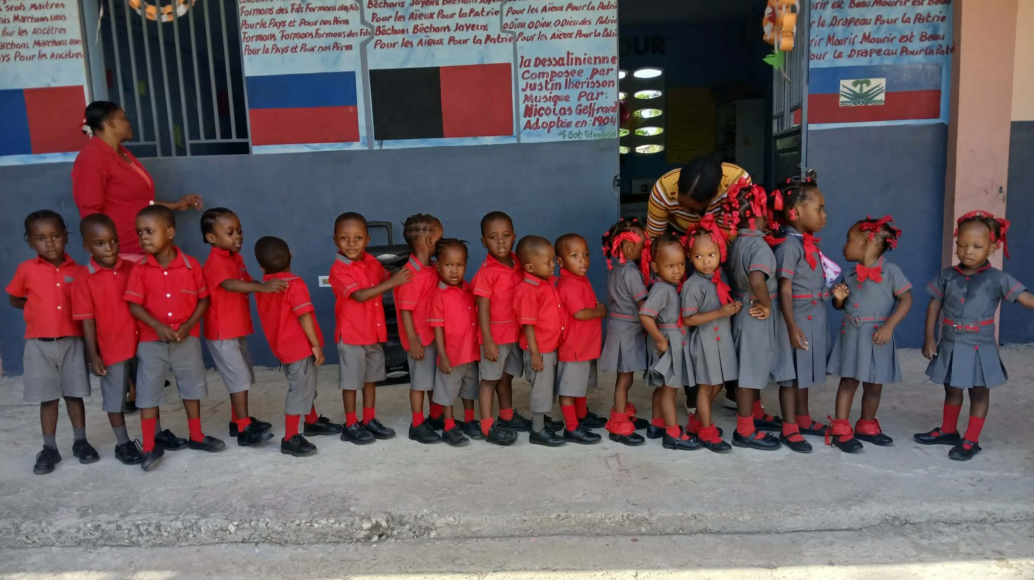
OUR MOTTO
Faith • Discipline • Excellence
Notes:
SHOW WHEN HE SAYS: "Our motto is: Faith – Discipline – Excellence"

Slide 21
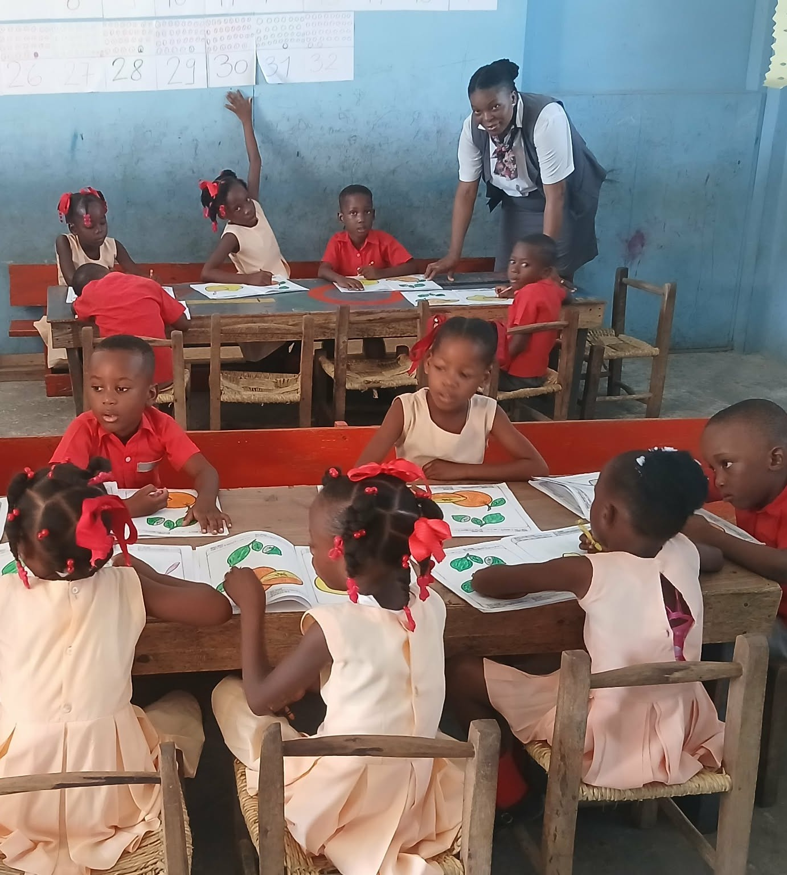
Educating the Whole Person
Discipline
Responsibility
Respect
Creativity
Leadership
Faith
Practical Skills
Vision for the Future
Notes:
SHOW WHEN HE SAYS: "We believe education should develop the whole person."

Slide 22
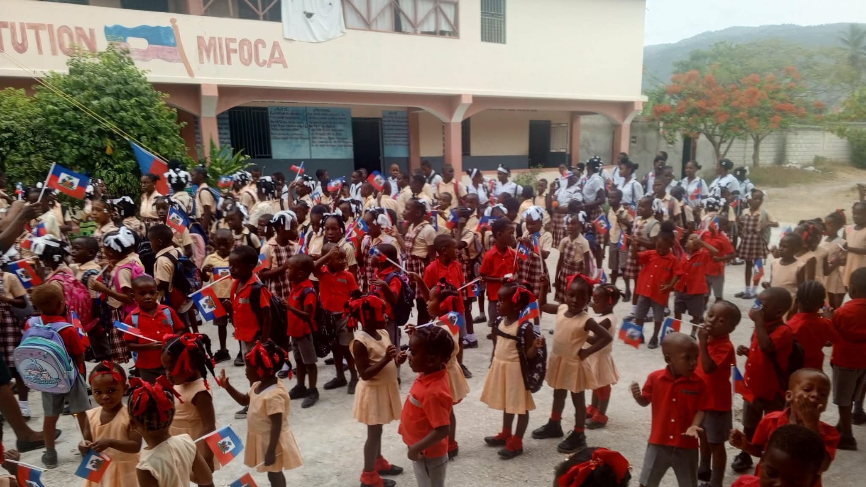
Educate a Child,
Change a Family
Notes:
SHOW WHEN HE SAYS: "Education is one of the most powerful tools we have for changing a community."

Slide 23





A Child Can Become…
Teacher
Nurse
Engineer
Business Owner
Pastor
Technician
Community Leader
Good Parent
Notes:
SHOW WHEN HE SAYS: "A child who receives a good education can become"

Slide 24
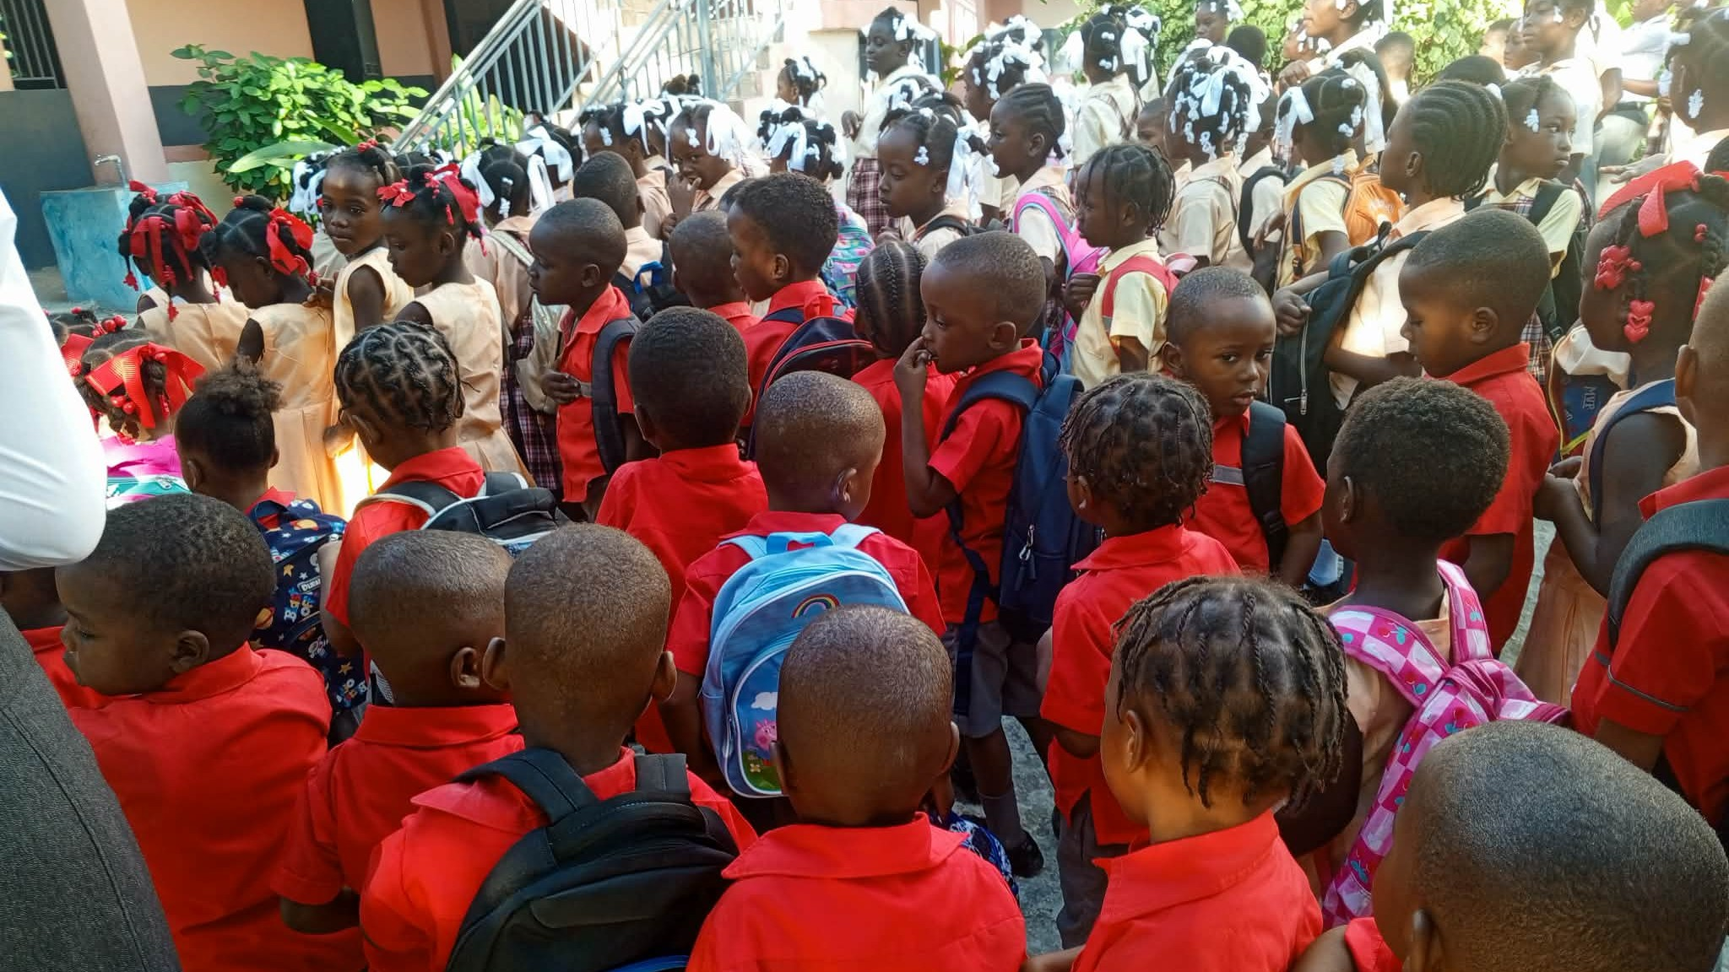
Education is not an expense.
It is an investment in the future.
Notes:
SHOW WHEN HE SAYS: "That is why we believe"

Slide 25
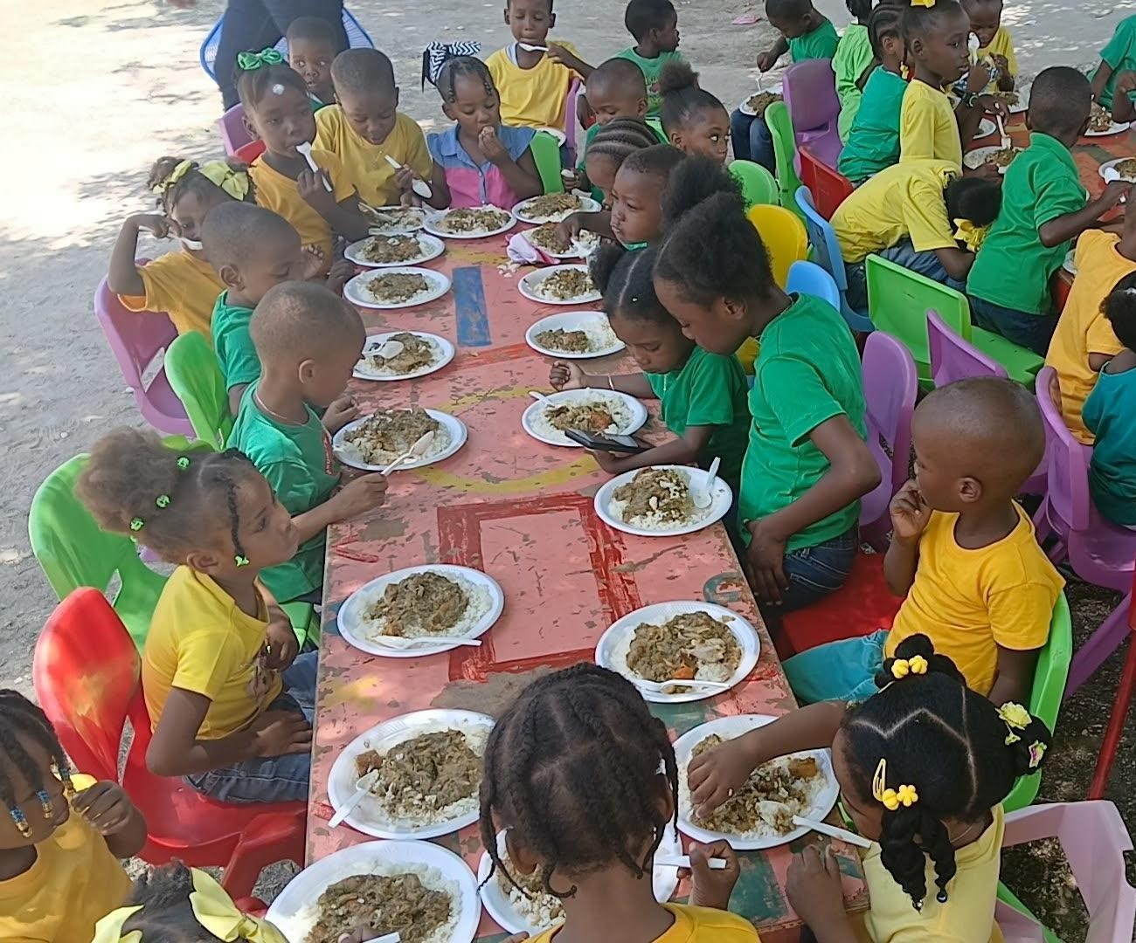
School Canteen
Hot meals for students
A hungry child cannot learn
Notes:
SHOW WHEN HE SAYS: "One of the areas that is especially important to us is our school feeding program."

Slide 26
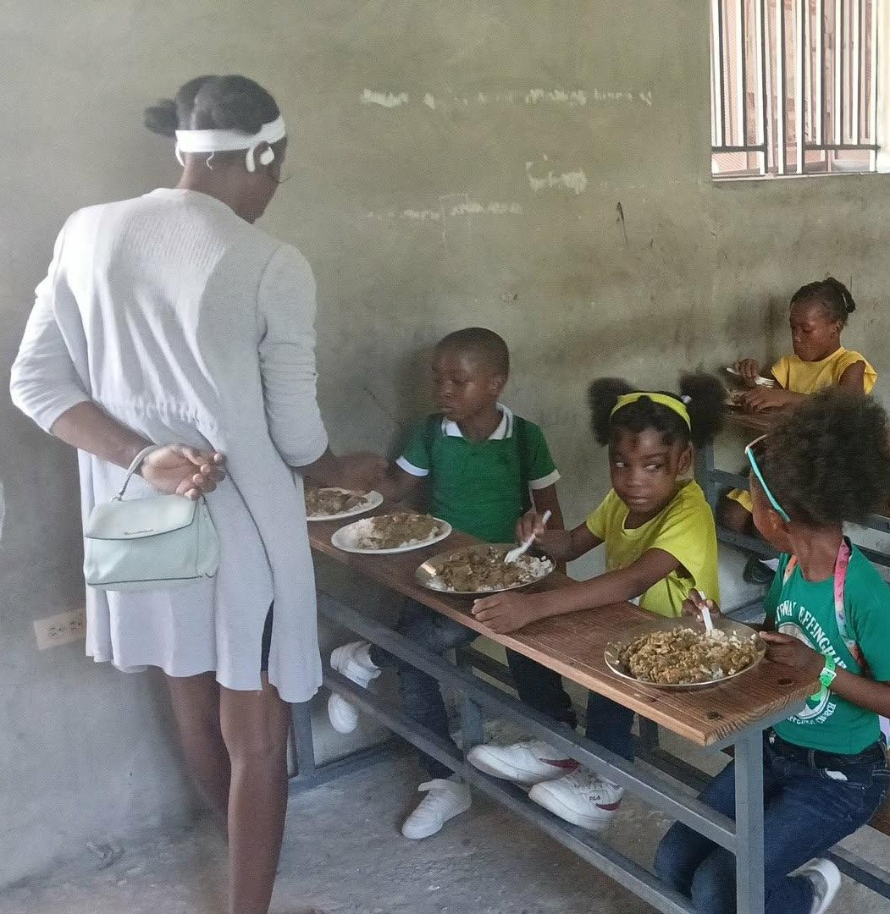



Every Meal Means…
Care
Dignity
Love
Hope
One of our greatest ongoing needs
Notes:
SHOW WHEN HE SAYS: "Every meal represents more than food."

Slide 27
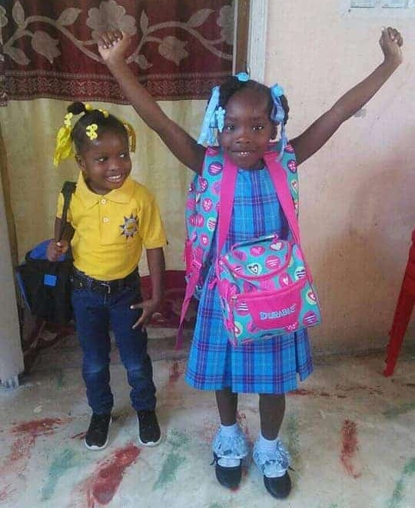
Helping Families
When a family struggles, the child struggles
We help with education, food, encouragement and prayer
Notes:
SHOW WHEN HE SAYS: "Our ministry also recognizes that children do not live separately from their families."

Slide 28
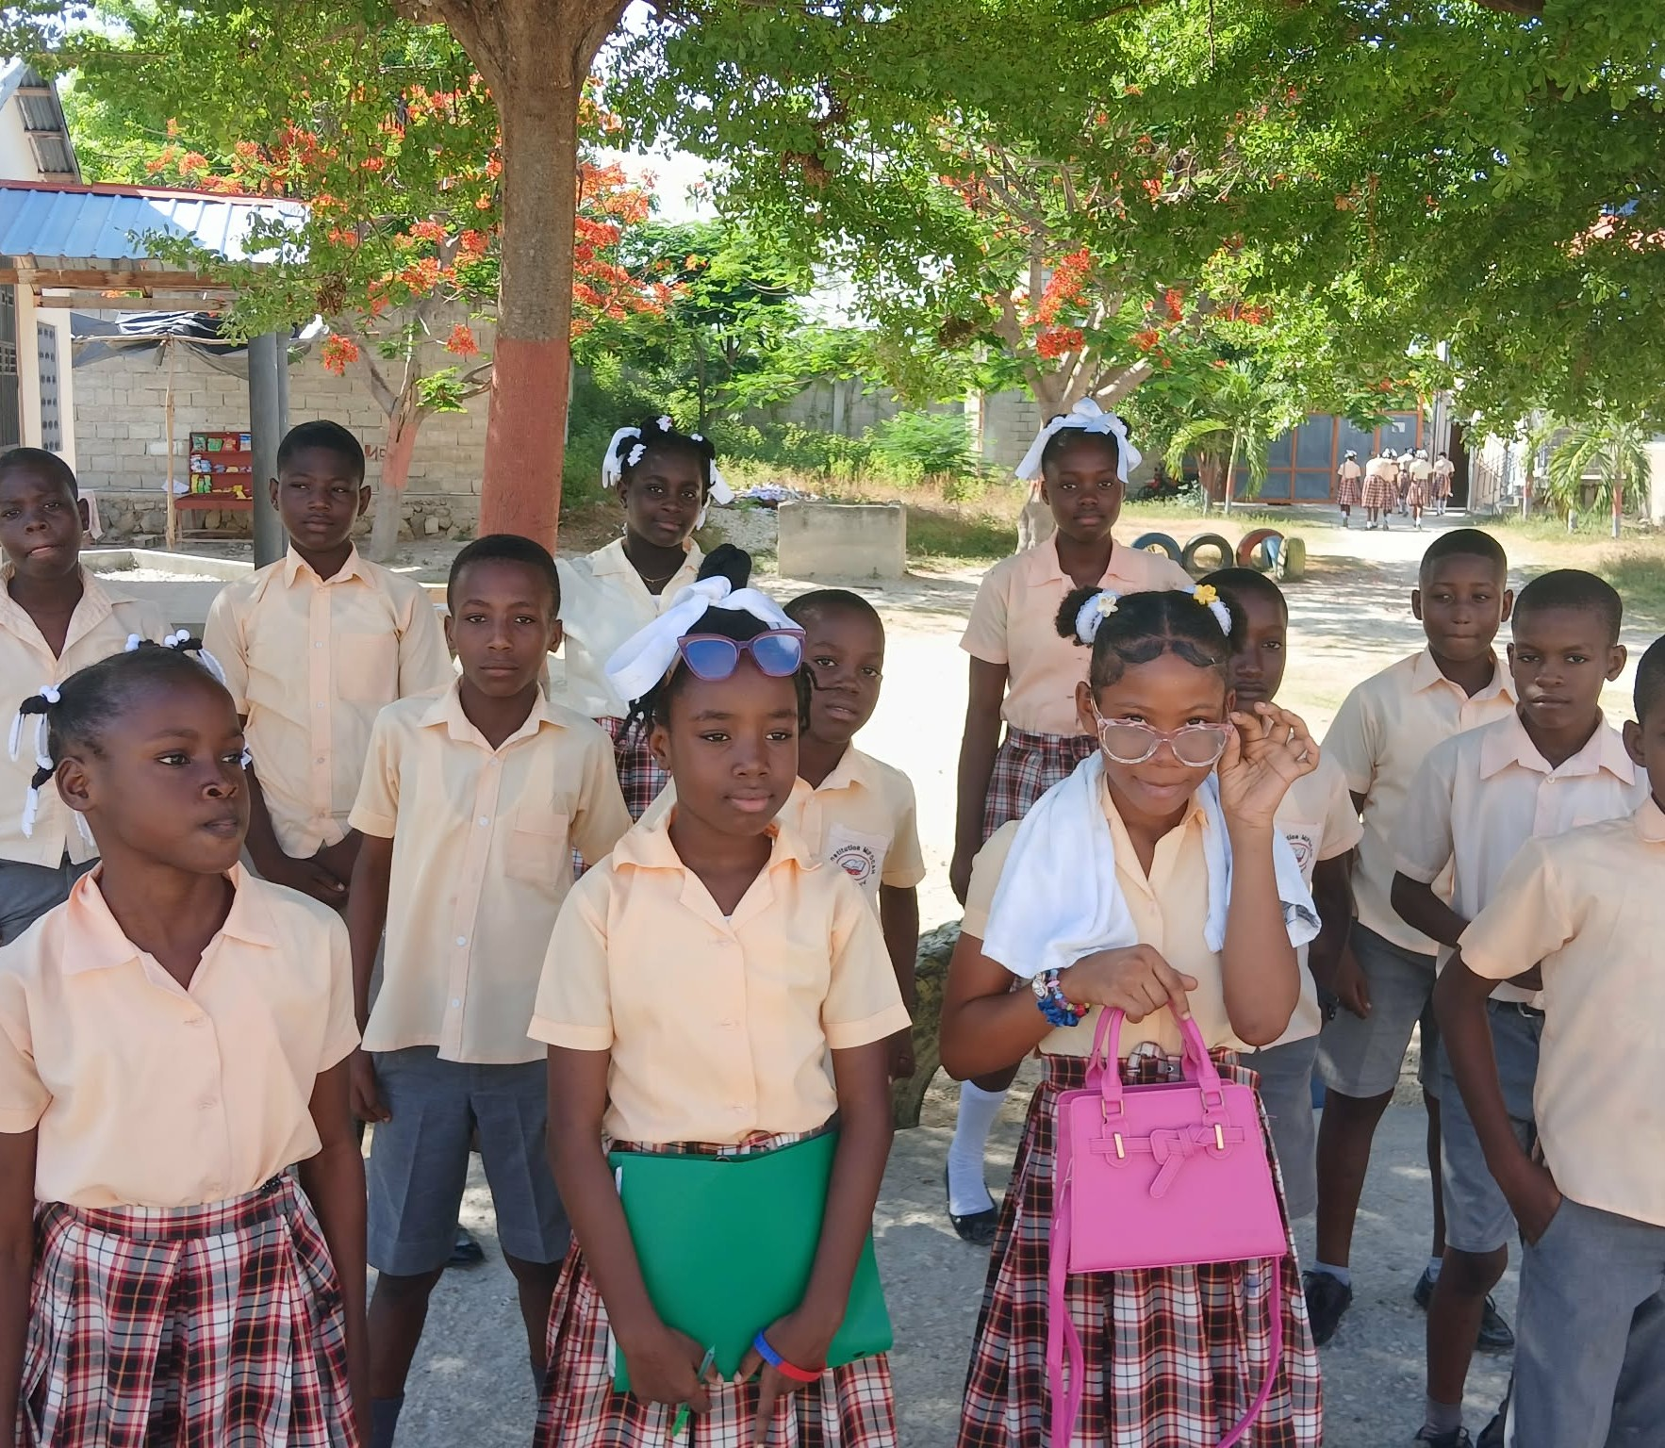
A Safe Place for Children to Play
(Wording to come — rest of script not received yet)
Notes:
SHOW WHEN HE SAYS: "A safe recreational space for children"

Slide 29


Our Greatest Needs
1
2
3
4
5
Teachers' Salaries
Children's Feeding Program
Well Pump
Solar Power System
Sunday Morning Feeding
$300 per month
$1.00 per child per day
Clean water for school and church
Inverter and lithium batteries
Church meal as community outreach
Notes:
SHOW WHEN HE SAYS: "(Not in the written script.) Show when he begins to talk about the ministry's needs."
Can also be shown at the end of his talk.

Slide 30
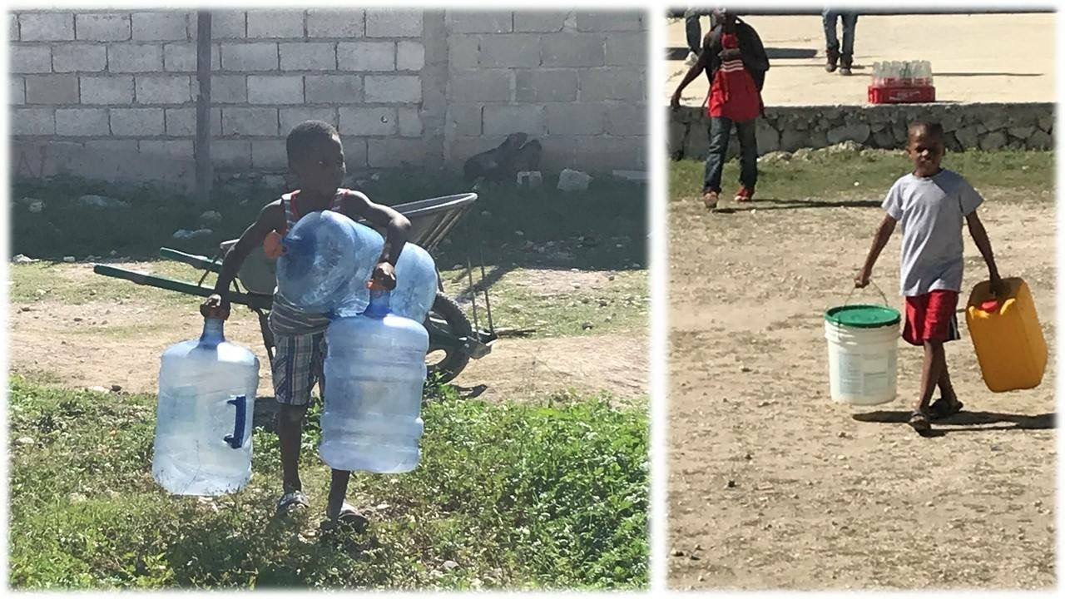
NEED #3: WELL PUMP
Carrying Water Every Day
Children carry heavy jugs and buckets to bring water home
Notes:
SHOW WHEN HE SAYS: he talks about the need for a well pump (not in the written script).
Show slides 30, 31 and 32 while he talks about water, about 10 seconds each if he does not mention them.

Slide 31
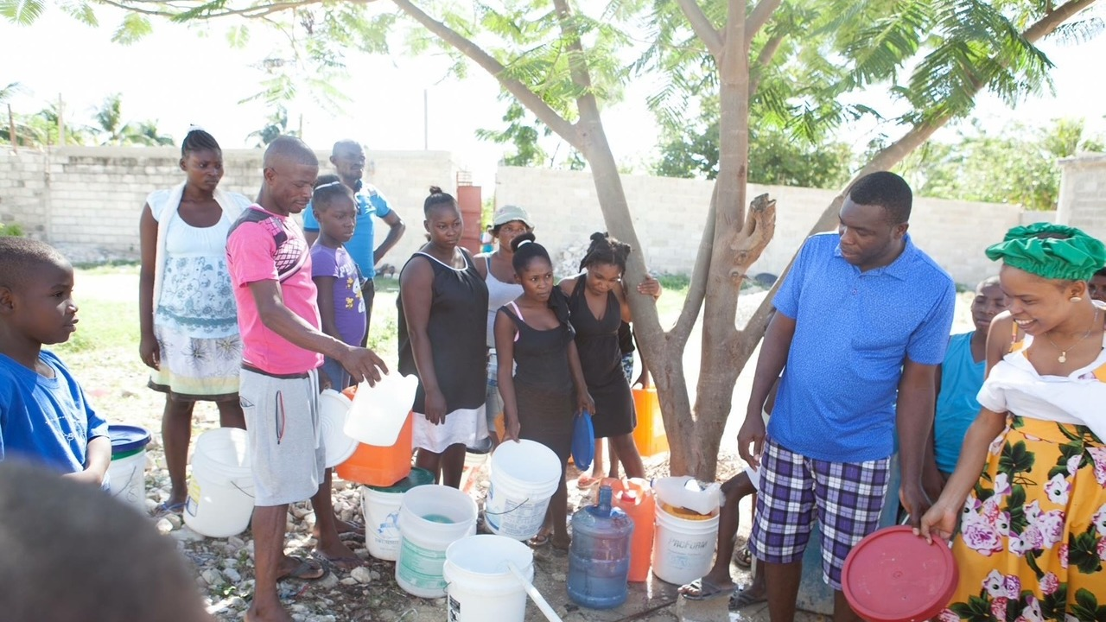
NEED #3: WELL PUMP
Waiting for Water
Families line up with their buckets to fill them
Notes:
SHOW WHEN HE SAYS: (continue) after about 10 seconds on slide 30.

Slide 32
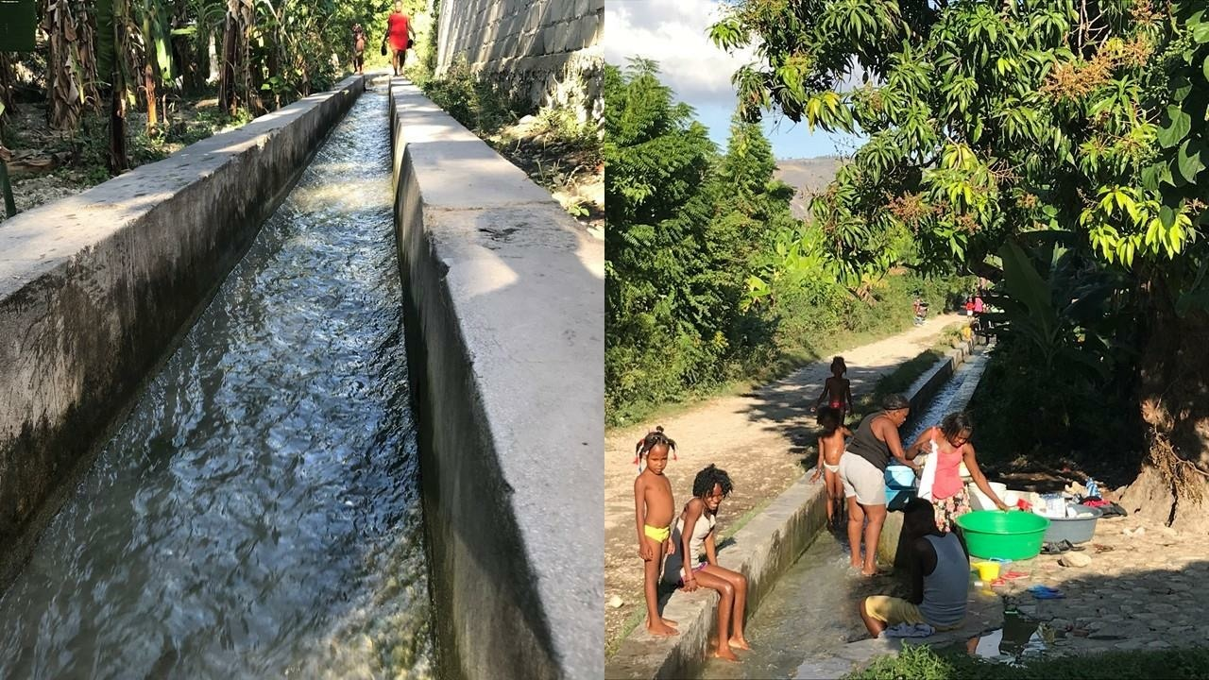
NEED #3: WELL PUMP
Water for Everything
Open canals are used for washing, bathing and laundry
Notes:
SHOW WHEN HE SAYS: (continue) after about 10 seconds on slide 31. Leave up until he moves on to how to help.

Slide 33



How You Can Help
Give through Baptists on Mission
Designate: "Romil-Haiti"
Follow on Facebook
@Rene Romil
Visit the website
www.equiphaiti.com
Notes:
SHOW WHEN HE SAYS: "(Not in the written script.) Show at the end of his talk."
Leave this slide up after he finishes so people can write down the information.

